Slide 1

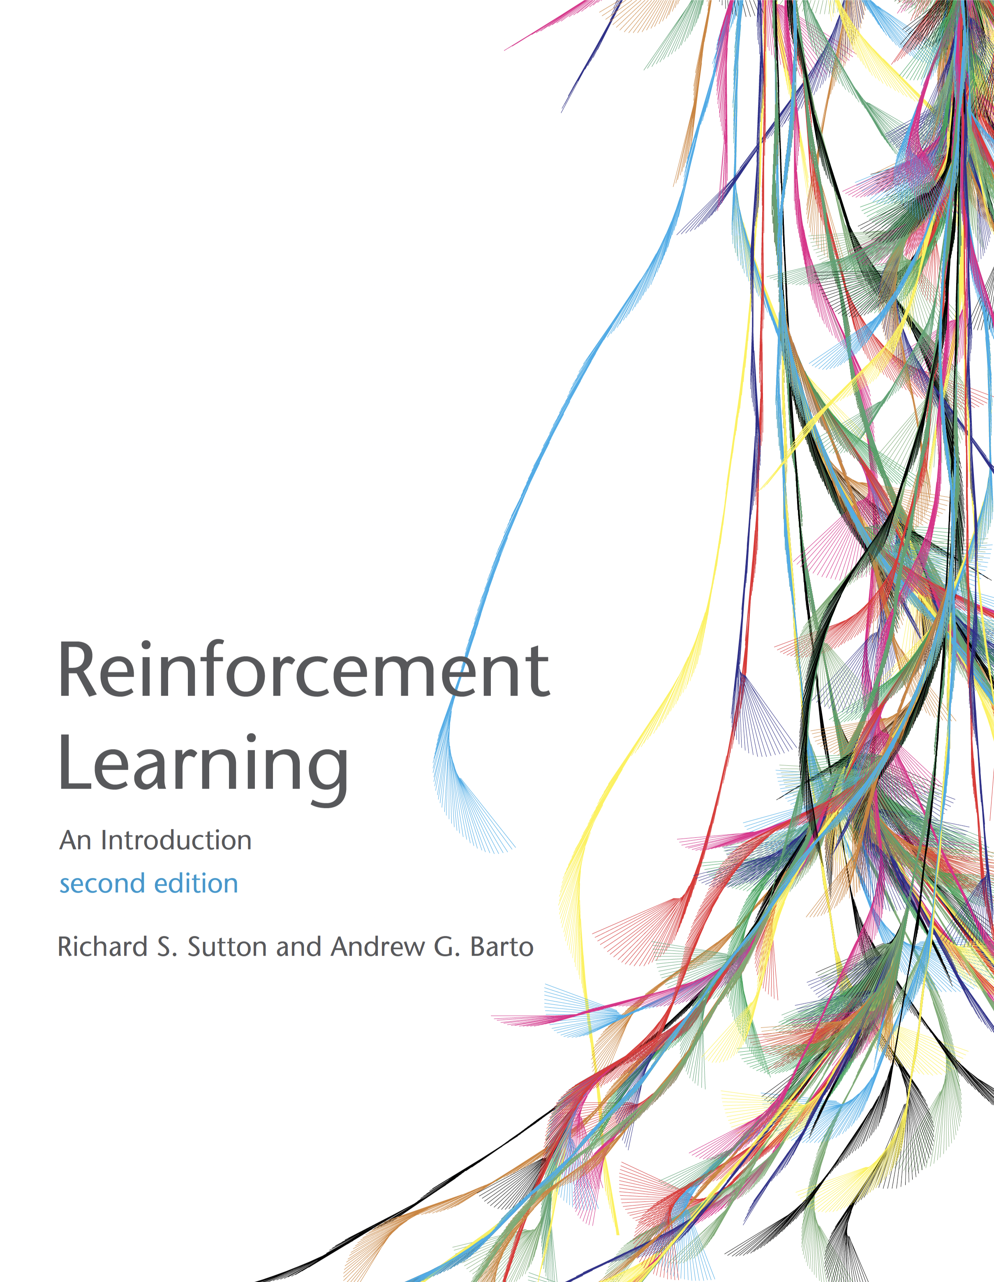
Markov Decision Processes
Sutton and Barto, Chapters 3 and Chapter 6.1, 6.2, 6.5 AIMA Chapter 17.1-17.3
Slides courtesy of Dan Klein and Pieter Abbeel University of California, Berkeley

Slide 2
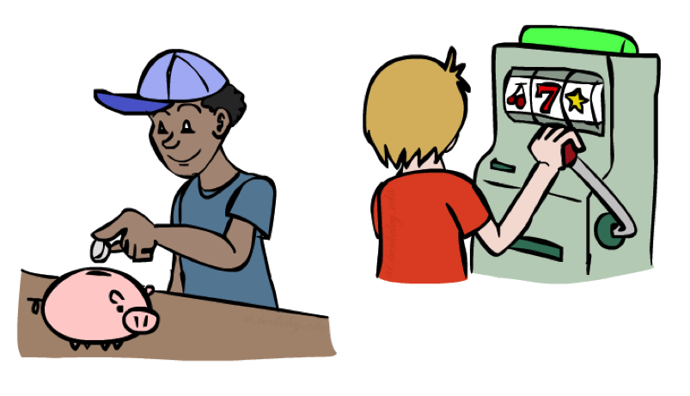
Review: Money
Money does not behave as a utility function, but we can talk about the utility of having money (or being in debt)
Given a lottery L = [p, $X; (1-p), $Y]
The expected monetary value EMV(L) is p*X + (1-p)*Y
The utility of the lottery is U(L) = p*U($X) + (1-p)*U($Y)
Typically, people express their utilities as: U(L) < U( EMV(L) )
In this sense, people are risk-averse. They would rather have a smaller amount of money than the gamble on the chance of having more.
Notes:
How about money? Can we use money as a utility scale? No! It’s not a good utility scale. We can talk about the utility of money, but it itself isn’t a good utility scale. Why not?
Imagine a lottery where you get X dollars or Y dollars.
Obviously, how good this is depends on X, Y and p.
Typically a utility of a lottery over money is worth less than its equivalent monetary value.
You’d rather have a smaller amount that is guaranteed.
How many of you would like a million dollars?
How many of you would like a billion dollars? How much more? 1000x more? Maybe not?
Let’s say I gave you a billion. Now how much do you want a million? Not much.
Diminishing returns. I’m told after your first billion, your second billion has less utility.
Same thing in the negative. Once you’re $1b in debt, whatever, you’re too big.

Slide 3
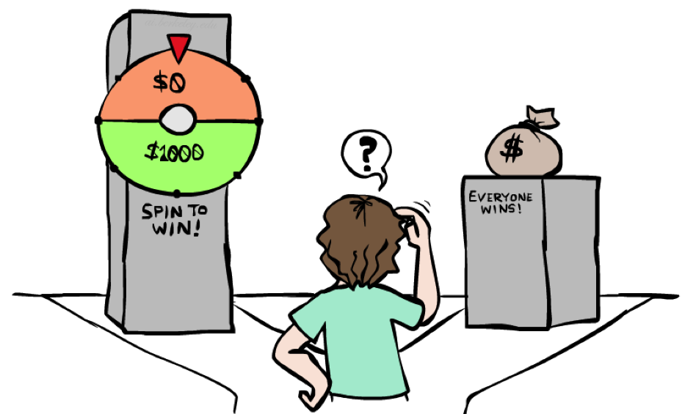
Example: Insurance
Consider the lottery [0.5, $1000; 0.5, $0]
What is its expected monetary value? ($500)
What is its certainty equivalent?
Monetary value acceptable in lieu of lottery
$400 for most people
Difference of $100 is the insurance premium
There’s an insurance industry because people will pay to reduce their risk
If everyone were risk-neutral, no insurance needed!
It’s win-win: you’d rather have the $400 and the insurance company would rather have the lottery (their utility curve is linear and they have many lotteries)
Notes:
Lottery example = $1000 computer, 50% chance that you’ll get it stolen, in which case you are left with $0.
Certainty equivalent. That’s how much money you would be willing to trade this lottery for. Trade uncertainty for certainty.
Certainty equivalent. How much would you trade this lottery for? How many would trade this for $10? How about $900? How about $400?
Because of these preferences there are things like insurance.
Is insurance just a scam? No, it’s win-win!

Slide 4
Example: Human Rationality?
Famous example of Allais (1953)
A: [0.8, $4k; 0.2, $0]
B: [1.0, $3k; 0.0, $0]
C: [0.2, $4k; 0.8, $0]
D: [0.25, $3k; 0.75, $0]
Most people prefer B > A, C > D
But if the utility of $0 is 0, that is U($0)=0, then
B > A ⇒ 1.0 U($3k) > 0.8 U($4k)
C > D = chance of C*4 > chance of D*4 ⇒ 0.8 U($4k) > 1.0 U($3k)
Notes:
Are humans perfectly rational? Here’s a classic experiment
B is the clear winner.
C is the winner.
Most people prefer C over D.
Multiply C and D by 4 and get the opposite conclusion 0.2*4 = 0.8, 0.25*4 = 1, so 0.8 U($4k) > 1.0 * U($3k)
So what the heck? You’re making irrational preferences? Are you irrational or did I do something wrong?
What do you get if you choose A, and you win $0? You get the feeling of stupidity.

Slide 5
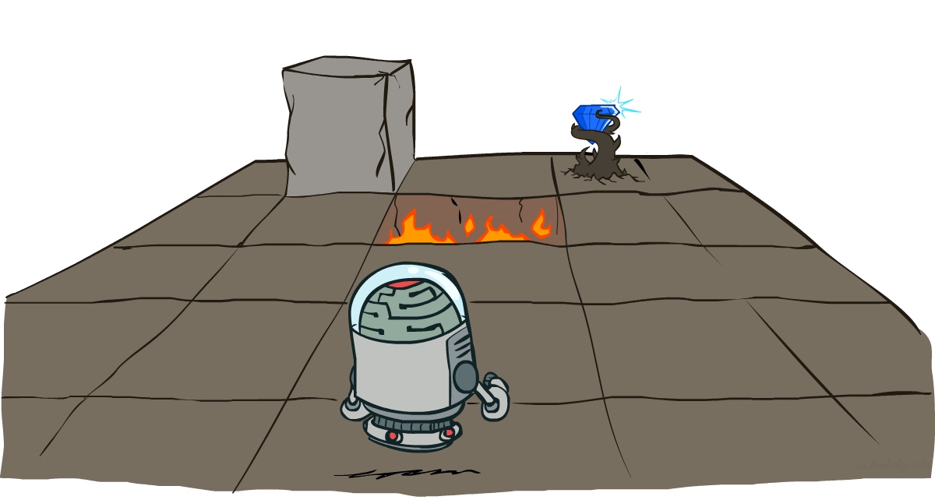
Markov Decision Processes
Slides courtesy of Dan Klein and Pieter Abbeel
University of California, Berkeley
[These slides were created by Dan Klein and Pieter Abbeel for CS188 Intro to AI at UC Berkeley. All CS188 materials are available at http://ai.berkeley.edu.]
Notes:
Please retain proper attribution, including the reference to ai.berkeley.edu. Thanks!

Slide 6
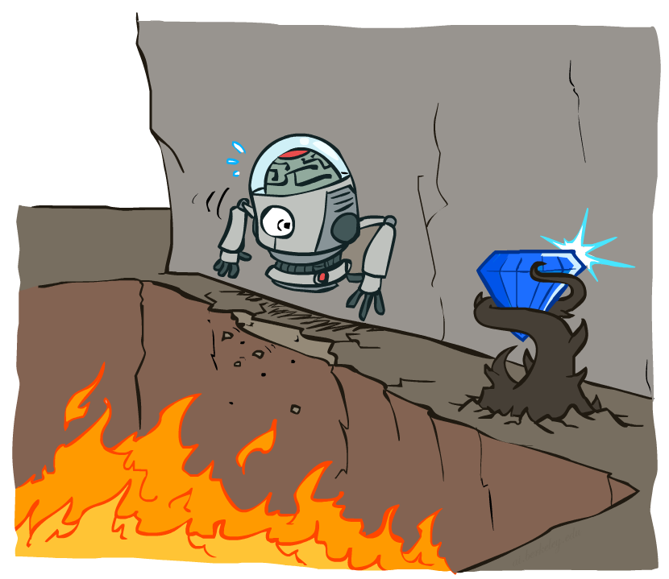
Non-Deterministic Search

Slide 7





Example: Grid World
A maze-like problem
The agent lives in a grid
Walls block the agent’s path
Noisy movement: actions do not always go as planned
80% of the time, the action North takes the agent North (if there is no wall there)
10% of the time, North takes the agent West; 10% East
If there is a wall in the direction the agent would have been taken, the agent stays put
The agent receives rewards each time step
Small “living” reward each step (can be negative)
Big rewards come at the end (good or bad)
Goal: maximize sum of rewards
Notes:
[cut demo of moving around in grid world program]

Slide 8

Policies
In deterministic single-agent search problems, we wanted an optimal plan, or sequence of actions, from start to a goal
For MDPs, we want an optimal policy π*: S → A
A policy π gives an action for each state
An optimal policy is one that maximizes expected utility if followed
An explicit policy defines a reflex agent
Expectimax didn’t compute entire policies
It computed the action for a single state only
Optimal policy when R(s, a, s’) = -0.03 for all non-terminals s
Notes:
Dan has a DEMO for this.

Slide 9
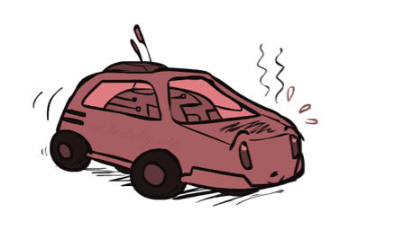
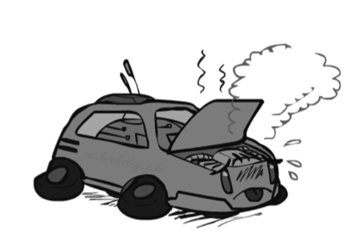
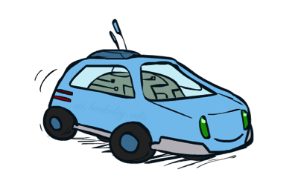
Example: Racing
A robot car wants to travel far, quickly
Three states: Cool, Warm, Overheated
Two actions: Slow, Fast
Going faster gets double reward
0.5
+1
1.0
Fast
Slow
-10
+1
0.5
Warm
Slow
Fast
0.5
+2
Cool
0.5
Overheated
+1
1.0
+2

Slide 10




Racing Search Tree

Slide 11



MDP Search Trees
Each MDP state projects an expectimax-like search tree
s
s is a state
a
(s, a) is a q-state
s, a
(s,a,s’) called a transition
T(s,a,s’) = P(s’|s,a)
R(s,a,s’)
s,a,s’
s’
Notes:
In MDP chance node represents uncertainty about what might happen based on (s,a) [as opposed to being a random adversary]
Q-state (s,a) is when you were in a state and have committed to take an action an action
Differences with expectimax tree: (1) Transition function encodes the probabilities. (2) Rewards are given on each state of the tree, rather than all the way on the bottom at the terminal nodes.

Slide 12
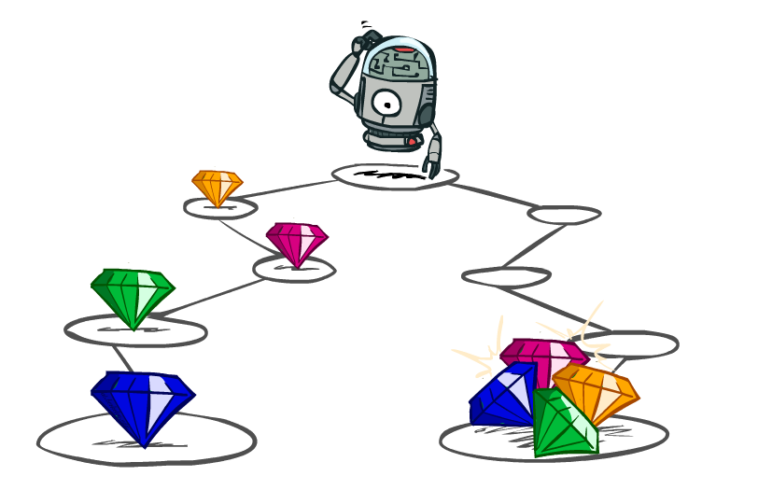
Utilities of Sequences
Notes:
In MDPs, rewards come to you step by step.
We need to decide what our reward function should be.
For example here, we might have a different way of rewarding this agent. One by giving the rewards incrementally, and one by giving them all at the end.

Slide 13
Utilities of Sequences
What preferences should an agent have over reward sequences?
More or less?
Now or later?
[1, 2, 2]
or
[2, 3, 4]
[0, 0, 1]
or
[1, 0, 0]
Notes:
Have students vote. For first one, pick More: [2,3,4] For now or less, if we added up, it doesn’t matter. But we prefer a reward now.

Slide 14




Discounting
It’s reasonable to maximize the sum of rewards
It’s also reasonable to prefer rewards now to rewards later
One solution: values of rewards decay exponentially
Worth Now
Worth Next Step
Worth In Two Steps
Notes:
Gamma will be set less than one.

Slide 15

Discounting
How to discount?
Each time we descend a level, we multiply in the discount once
Why discount?
Sooner rewards probably do have higher utility than later rewards
Also helps our algorithms converge
Example: discount of 0.5
U([1,2,3]) = 1*1 + 0.5*2 + 0.25*3
U([1,2,3]) < U([3,2,1])
Notes:
Rewards in the future (deeper in the tree) matter less.
Discount of 0.5 is pretty harsh. At each time step the reward is only worth half as much as in the previous step.
Interesting: running expectimax, if having to truncate the search, then not losing much; e.g., less then \gamma^d / (1-\gamma)

Slide 16
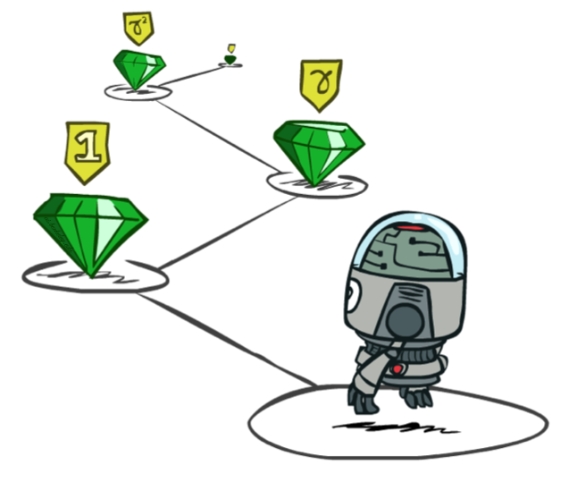
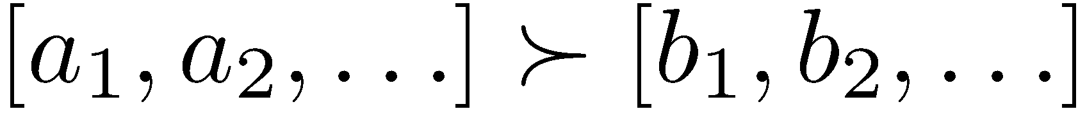
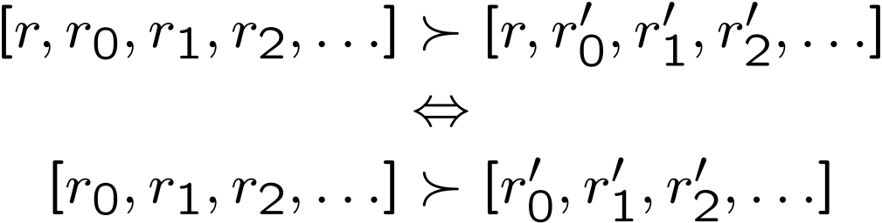
Stationary Preferences
Theorem: if we assume stationary preferences:
Then: there are only two ways to define utilities
Additive utility:
Discounted utility:
Notes:
Stationary preferences iff we stick one reward in the front, that implies that the relationship are the same.
R is a reward.
Actually only one way, since if gamma were 1, then the discounted utility would be the additive utility.

Slide 17
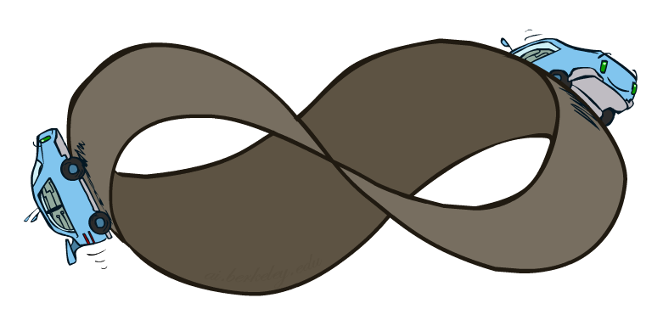
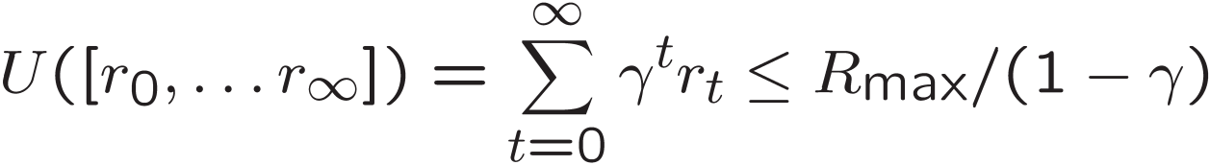
Infinite Utilities?!
Problem: What if the game lasts forever? Do we get infinite rewards?
Solutions:
Finite horizon: (similar to depth-limited search)
Terminate episodes after a fixed T steps (e.g. life)
Gives nonstationary policies (π depends on time left)
Discounting: use 0 < γ < 1
Smaller γ means smaller “horizon” – shorter term focus
Absorbing state: guarantee that for every policy, a terminal state will eventually be reached (like “overheated” for racing)

Slide 18
Recap: Defining MDPs
Markov decision processes:
Set of states S
Start state s₀
Set of actions A
Transitions P(s’|s,a) (or T(s,a,s’))
Rewards R(s,a,s’) (and discount γ)
MDP quantities so far:
Policy = Choice of action for each state
Utility = sum of (discounted) rewards
s
a
s, a
s,a,s’
s’

Slide 19
Solving MDPs

Slide 20
Optimal Quantities
The value (utility) of a state s:
V*(s) = expected utility starting in s and acting optimally
The value (utility) of a q-state (s,a):
Q*(s,a) = expected utility starting out having taken action a from state s and (thereafter) acting optimally
The optimal policy:
π*(s) = optimal action from state s
s
s is a state
a
(s, a) is a q-state
s, a
s,a,s’
(s,a,s’) is a transition
s’
Notes:
Utility at state S is exactly what would happen if you ran expectimax at state s.
Q state is the value of undertaking the action A, (TOO LATE TO TURN BACK) and then computing the optimal util
Pi is a policy. Pi* is the optimal policy from state s.

Slide 21
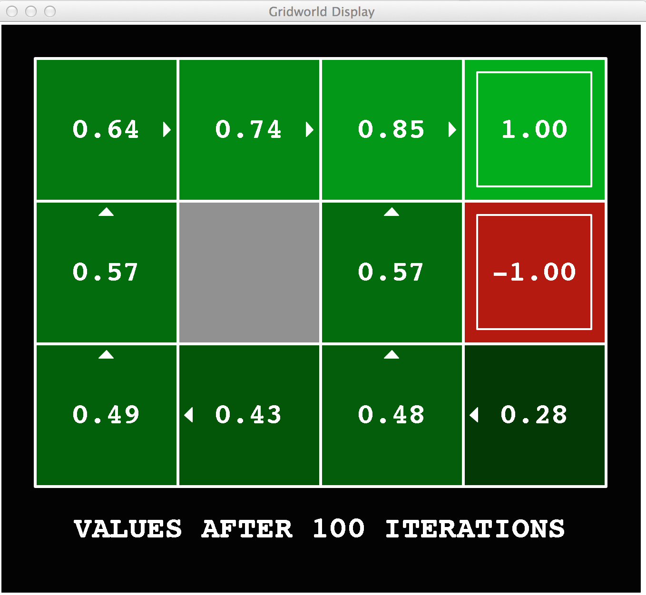
Gridworld Values V*
Notes:
Here’s one particular setting for Gridworld. (Remember that we had some

Slide 22
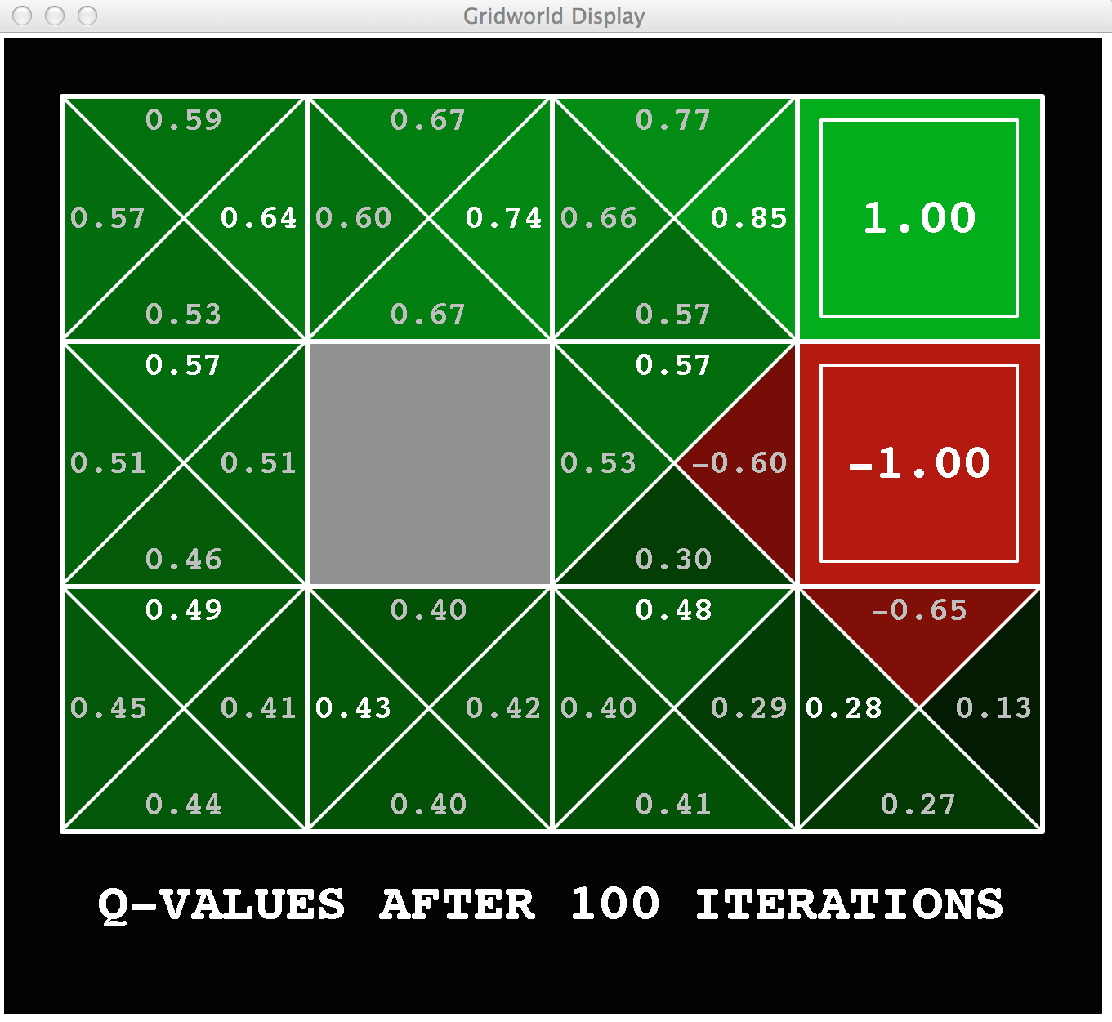
Gridworld: Q*

Slide 23


Values of States
Fundamental operation: compute the (expectimax) value of a state
Expected utility under optimal action
Average sum of (discounted) rewards
This is just what expectimax computed!
Recursive definition of value:
s
a
s, a
s,a,s’
s’
Notes:
Write these out on the board. Max over chance nodes. That’s really just what expectimax was doing.
What do I do at a chance node Q(s,a).?
I’m going to get a reward. R(s,a,s’). Plus I’m going to get all the future rewards from this state V*(s’).
Both of course, I don’t know what’s going to happen at the chance node, so I need to sum over all states s’
We’re going to weight these by the relative probability that comes from our probability function. We write that T(s,a,s’).
We’re missing one thing. The discount of the future value. So we multiply that by Gamma.
This may look complicated, but you’re going to see this many times in the future. Don’t go into math shock. You can understand this.
We can also write this in one step. We write the expectimax recurrenece.
This is called a Bellman equation. We’re going to come back to this a lot starting in the next lecture.

Slide 24
Racing Search Tree

Slide 25

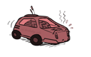
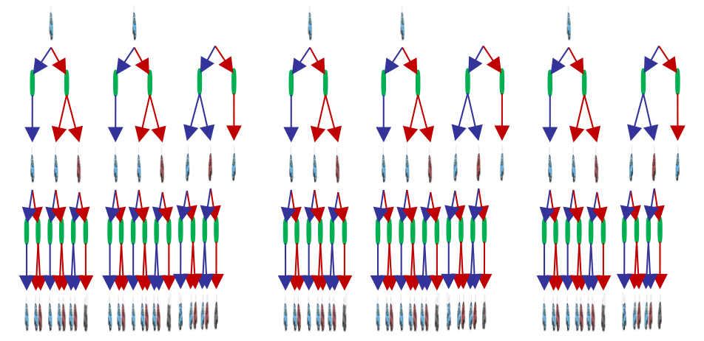
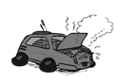
Racing Search Tree
Notes:
The tree gets very big very quickly. But I might think that expectimax is a colossal waste of time for this problem.

Slide 26
Racing Search Tree
We’re doing way too much work with expectimax!
Problem: States are repeated
Idea: Only compute needed quantities once
Problem: Tree goes on forever
Idea: Do a depth-limited computation, but with increasing depths until change is small
Note: deep parts of the tree eventually don’t matter if γ < 1
Notes:
At depth 100, then you have gamma to the 100. So it’s not going to contribute much at all.
We return to the same state over and over again. This might of remind you of Graph Search instead of Tree search.

Slide 27


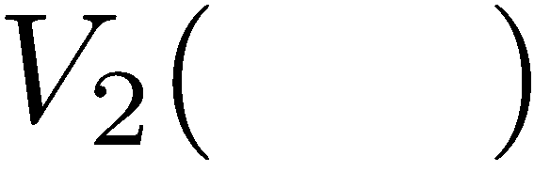

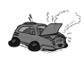
Time-Limited Values
Key idea: time-limited values
Define V_{k}(s) to be the optimal value of s if the game ends in k more time steps
Equivalently, it’s what a depth-k expectimax would give from s
Notes:
V_k is a time limited definition of V(s)

Slide 28
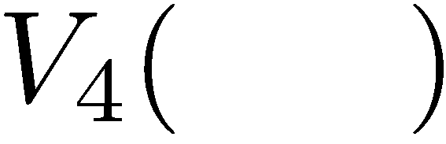

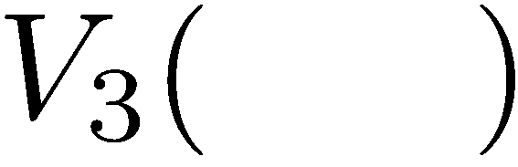
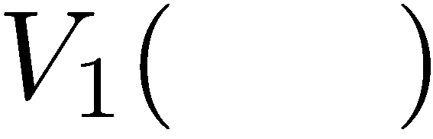
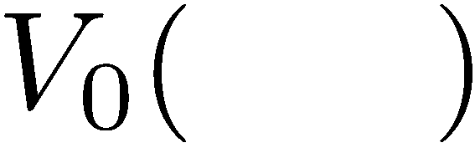
Computing Time-Limited Values
Notes:
V0, we know what it is it’s 0 for any state.
V1, is a depth 1 expectimax computation.
Each layer is a V_k for an increasing value of k.

Slide 29
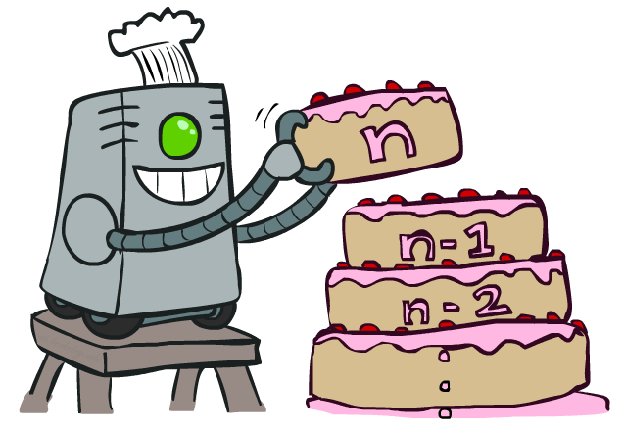
Value Iteration
Notes:
That’s an algorithm called value iteration. You can think of this as building your value from the bottom up. It will behave similarly to expectimax, but will be a lot less work, when we only have a small number of states. Let’s see how it works.

Slide 30
Value Iteration
Start with V₀(s) = 0: no time steps left means an expected reward sum of zero
Given vector of V_{k}(s) values, do one ply of expectimax from each state:
Repeat until convergence
Complexity of each iteration: O(S²A)
Theorem: will converge to unique optimal values
Basic idea: approximations get refined towards optimal values
Policy may converge long before values do
V_{k+1}(s)
a
s, a
s,a,s’
V_{k}(s’)
Notes:
We are going to store all of the V values in a vector. For V_0, everything is just 0.
The recursion is into an Expectimax tree that we have already compted. The recursion won’t actually happen because we’ve already got it.
What will this do, we can go from 0, to 1 to 2, to K. Each time we will go deeper into the tree. When should we stop? When the values start to converge.
Complexity = we do this update for each state, then we do a little expectimax. We do a for loop over A to take take a max over each action, then we do another for loop that goes over each state again.

Slide 31

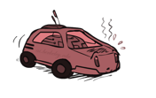
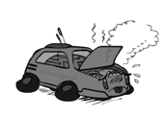
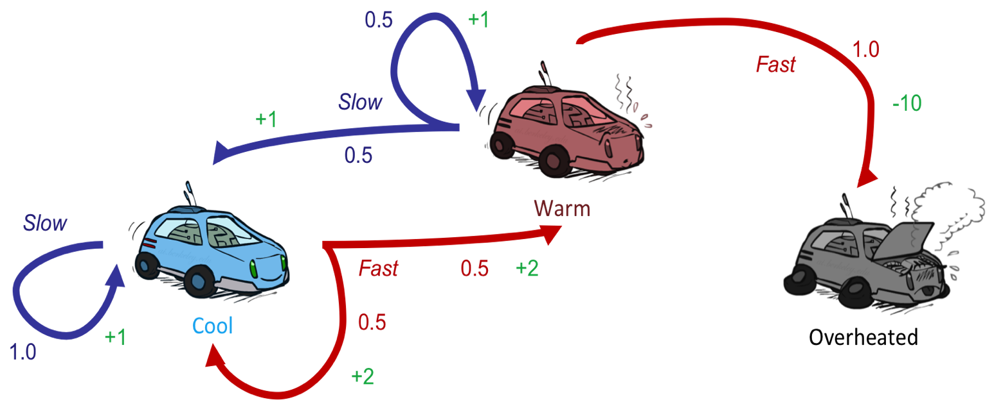
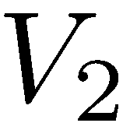
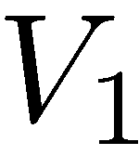
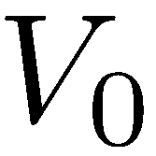
Example: Value Iteration
Assume no discount!
Notes:
V0 = 0 , 0 , 0
For V1. [2,1,0]
On we’re going to do a little expectimax search for each value. As an equation that’s the V_k+1 ….
Let’s start with the cool state. But let’s think about it in terms of actions. What should I do. If I go slow, then I get +1, if I go fast then I get +2.
Now with the fast state, if I go slow then I get +1, if I go fast then I get -10. so max value is 1.
For V2, [3.5, 2.5, 0]
Cool:
SLOW If I go slow then what do I get? I get 1, and if there’s no discount, then I’m going to land back at cool, so 2 is the Vk-1. Total is 2.
FAST If I go fast, then I’ve got a 2 instantaneously then I have a 50%/50% chance of plugging in 2 because I got sent back to cool, and plugging in 1 if I go to 1. Total = 3.5
So for cool, the max works out to 3.5
If I work that out for the warm state, then that comes out to 2.5.
As I go further up, then the numbers go up. That makes sense because I’m accumulating rewards at each step.
From this we can work out an optimal policy (when you’re cool go fast when you’re warm go slow).

Slide 32
Example: Value Iteration
3.5 2.5 0
2 1 0
Assume no discount!
0 0 0
Notes:
V0 = 0 , 0 , 0
For V1.
On we’re going to do a little expectimax search for each value. As an equation that’s the V_k+1 ….
Let’s start with the cool state. But let’s think about it in terms of actions. What should I do. If I go slow, then I get +1, if I go fast then I get +2.
Now with the fast state, if I go slow then I get +1, if I go fast then I get -10. so max value is 1.
For V2,
Cool:
SLOW If I go slow then what do I get? I get 1, and if there’s no discount, then I’m going to land back at cool, so 2 is the Vk-1. Total is 2.
FAST If I go fast, then I’ve got a 2 instantaneously then I have a 50%/50% chance of plugging in 2 because I got sent back to cool, and plugging in 1 if I go to 1. Total = 3.5
So for cool, the max works out to 3.5
If I work that out for the warm state, then that comes out to 2.5.
As I go further up, then the numbers go up. That makes sense because I’m accumulating rewards at each step.
From this we can work out an optimal policy (when you’re cool go fast when you’re warm go slow).

Slide 33
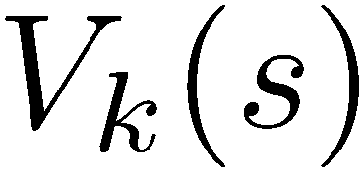
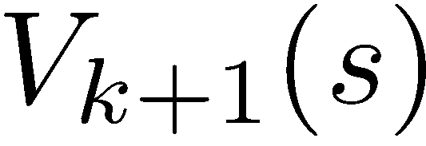
Convergence*
How do we know the V_{k} vectors are going to converge?
Case 1: If the tree has maximum depth M, then V_{M} holds the actual untruncated values
Case 2: If the discount is less than 1
Sketch: For any state V_{k} and V_{k+1} can be viewed as depth k+1 expectimax results in nearly identical search trees
The difference is that on the bottom layer, V_{k+1} has actual rewards while V_{k} has zeros
That last layer is at best all R_{MAX}
It is at worst R_{MIN}
But everything is discounted by γ^{k} that far out
So V_{k} and V_{k+1} are at most γ^{k} max|R| different
So as k increases, the values converge
Notes:
If the game is infinite, like in racing then it won’t converge.
Imagine tree V_k is actually depth V_k+1, but the last layer is all 0.
Draw height as k+1. Fill in bottom as 0.
…
How fast it converges, depends on the effective depth, or gamma. As gamma gets closer to 1, then the effective depth is deeper.

Slide 34

The Bellman Equations
How to be optimal:
Step 1: Take correct first action
Step 2: Keep being optimal

Slide 35

The Bellman Equations
Definition of “optimal utility” via expectimax recurrence gives a simple one-step lookahead relationship amongst optimal utility values
These are the Bellman equations, and they characterize optimal values in a way we’ll use over and over
s
a
s, a
s,a,s’
s’
Notes:
Let’s start by equations that characterize these quantities through mutual recursions. [step through this by writing on slide, one step at a time]
Recursive characterization of V* in terms of V*; not necessarily helpful; but it is a characterization.
Note: this is a set of equations that needs to be satisfied; but it could have multiple solutions (it does not, but at this stage of our knowledge it could).

Slide 36
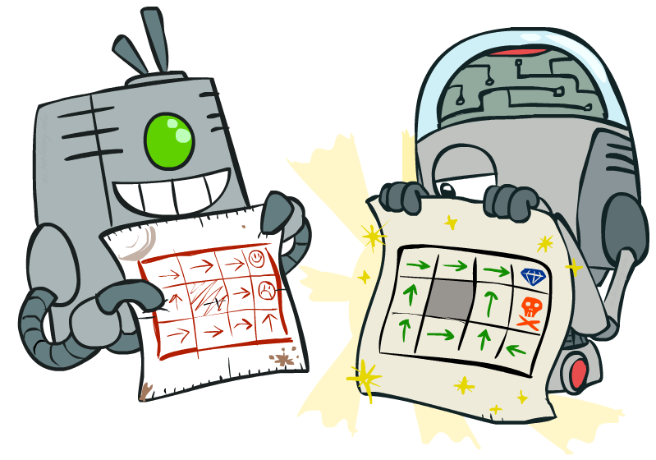
Policy Methods
Notes:
Good policies v. bad policies. Methods to work over policies to make them better, rather than over values.

Slide 37
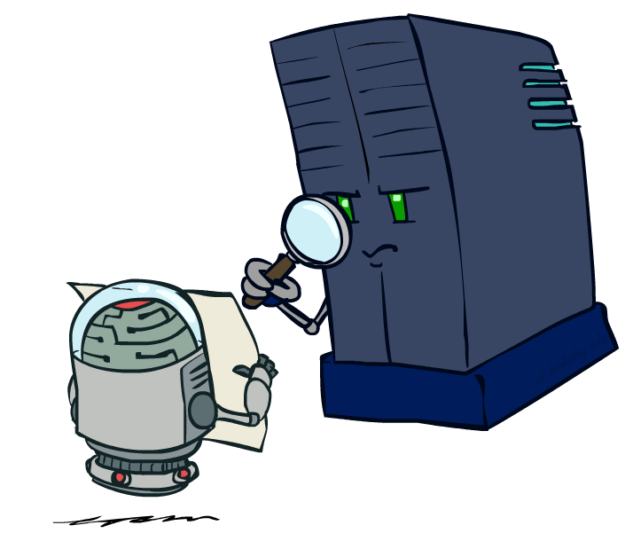
Policy Evaluation
Notes:
Figure out for a policy, what the values are.

Slide 38
Fixed Policies
Do the optimal action
Do what π says to do
s
s
a
π(s)
s, a
s, π(s)
s,a,s’
s, π(s),s’
s’
s’
Expectimax trees max over all actions to compute the optimal values
If we fixed some policy π(s), then the tree would be simpler – only one action per state
… though the tree’s value would depend on which policy we fixed
Notes:
So far we’ve only been talking about executing under optimal actions. That gave us optimal values and therefore optimal behaviors.
Here we’re going to talk about what to do under a fixed policy, pi.
If I have a fixed policy, then I don’t have a lot choices. I don’t have to max over the set of possible actions anymore. Essentially the tree is pruned.

Slide 39
Utilities for a Fixed Policy
Another basic operation: compute the utility of a state s under a fixed (generally non-optimal) policy
Define the utility of a state s, under a fixed policy π:
V^{π}(s) = expected total discounted rewards starting in s and following π
Recursive relation (one-step look-ahead / Bellman equation):
s
π(s)
s, π(s)
s, π(s),s’
s’
Notes:
Under optimal policies one thing we needed to do was to calculate the utility of a state.
We’ll need to do that again. Now it’s actually easier.
We need to write an equation. We used to write a maximum. We don’t need to do that anymore. But we still need to consider all possible outcomes.
The function pi takes in a state and returns an action. It could be implemented in code as a hash table. Same kind of bellman equation, but the max over a is gone. Recursive relation that is a one step look ahead.

Slide 40
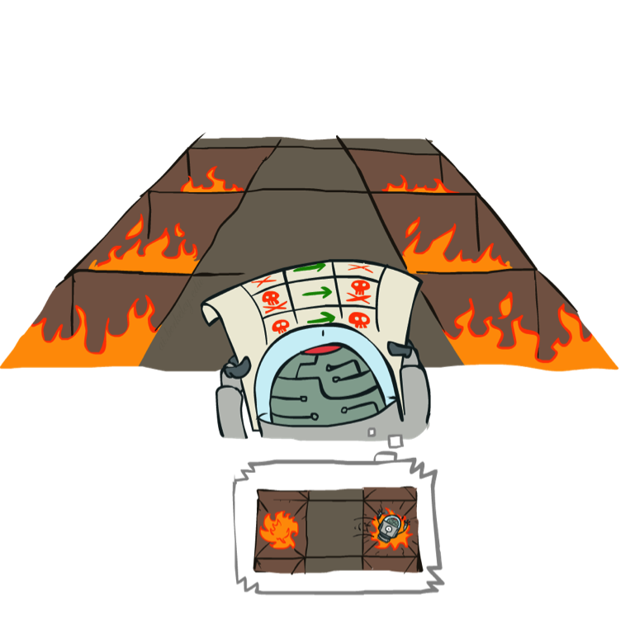
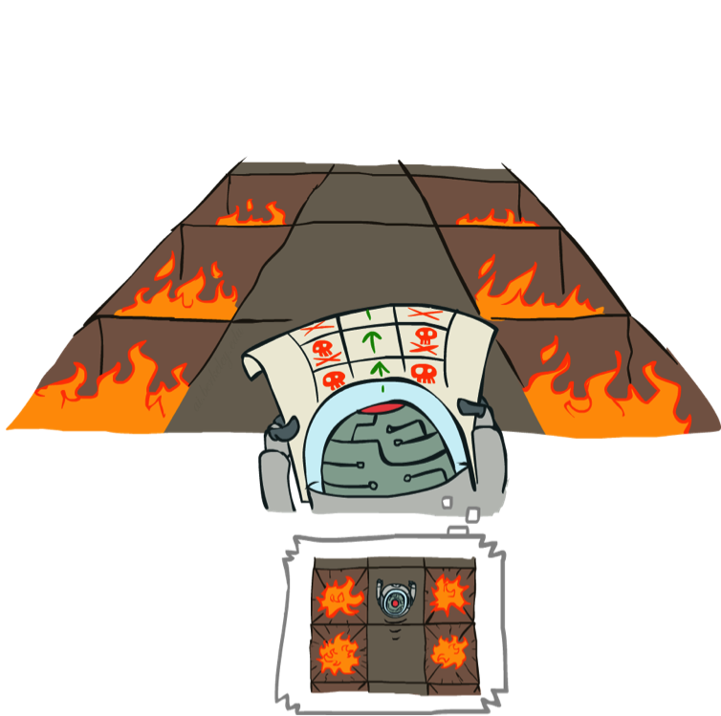
Example: Policy Evaluation
Always Go Right
Always Go Forward
Notes:
Here’s an example of policy evaluation. How about this one? It’s bad. The agent can simulate it in its head and decide that it is bad.
This one looks better. The robot can think about it and decide that it’s better than the previous one.
If it’s got a choice then it will pick this policy.

Slide 41
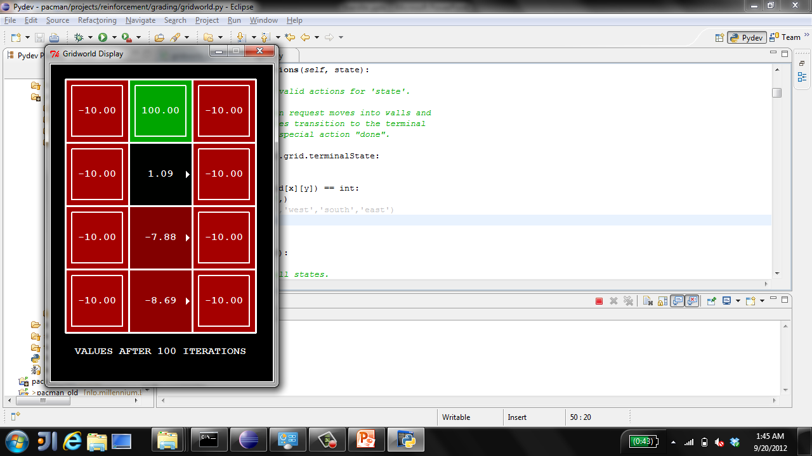
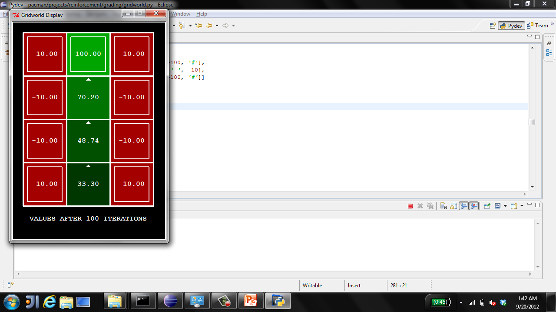
Example: Policy Evaluation
Always Go Right
Always Go Forward
Notes:
Here’s how the values work out.
The always go right one doesn’t work out so well in less you’re on the exit square. But importantly, it has values. So we can evaluate how good it is.
The second has better values.
The reason we want to evaluate policies, is that we will look at algorithms that start with one policy, evaluate it, and then look at ways of improving it.

Slide 42

Policy Evaluation
s
How do we calculate the V’s for a fixed policy π?
Idea 1: Turn recursive Bellman equations into updates
(like value iteration)
Efficiency: O(S²) per iteration
Idea 2: Without the maxes, the Bellman equations are just a linear system
Solve with Matlab (or your favorite linear system solver)
π(s)
s, π(s)
s, π(s),s’
s’
Notes:
One way is to look at it just like value iteration.
At V_0, give 0.
Then recursively, compute it for iteratively higher k.
Imagine I have k+1 time steps left.
Take the action pi of S.
Average over all possible states s’
Add the instantaneous reward R
plus the discounted future reward at the landing state s until the end of time.
This is more efficient than standard value iteration.
For every iteration, we visit each state. The maximum number of possible landing states s’ is s. This assumes that every state is connected to every other state, which is usually not the case, so this is an upper bound on the complexity.
This O(S^2) no longer has the A term.
Without the maxes, you can actually just solve it as a system of linear equations.

Slide 43
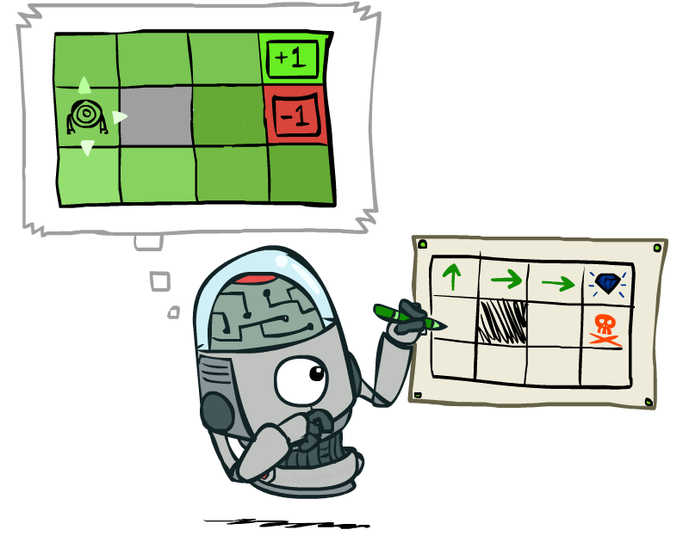
Policy Extraction
Notes:
OK, so we just looked at the situation where we are given a policy, and we need to assign values to it.
Now let’s look at the opposite. Given a set of values (which we assume to be correct), what’s the best policy?

Slide 44
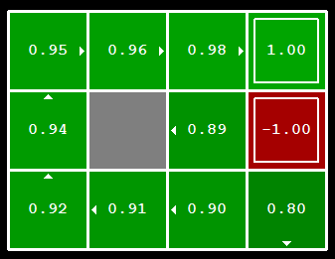
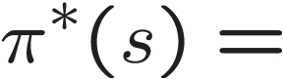
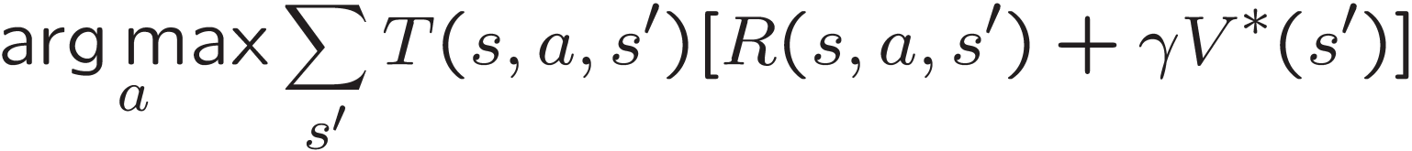
Computing Actions from Values
Let’s imagine we have the optimal values V*(s)
How should we act?
It’s not obvious!
We need to do a mini-expectimax (one step)
This is called policy extraction, since it gets the policy implied by the values
Notes:
Let’s compute the actions to take given the values.
Someone gives us the optimal values.
How should I act?
Look at the interesting square on the ledge.
.89 – that’s not bad. Should I choose to go North? South? It turns out that here we shouldn’t go north to the .98, but we shouldn’t head in that direction. We should hit the wall and wait to move up by chance.
The values let you figure out that the square to the north is better than you, but not how to get there.
So it’s not obvious how to act optimally given the values.
If you didn’t have the helpful arrows here, and you only had the optimal values, how would you figure out how to act.
The answer to that is you basically have to do expectimax.
You have to unroll this and see which was the action that gave rise to these values.
We don’t have to do it very deeply. We’ll see when we unroll it we’ll need to recurse, but we’ve already got those actions, so we only have to go one step deep.
[write equation on the board, initially omitting argmax]
…
The discounted future is given to us, since we have V*(s).
Notation over a is arg max. Instead of giving me the maximum value, it gives me the action a that achieves the maximum.
This one step look ahead according to a given set of values is called policy extraction, since it returns the policy implied by the values.

Slide 45
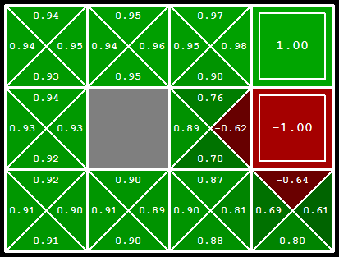
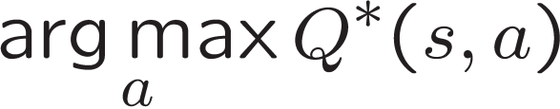
Computing Actions from Q-Values
Let’s imagine we have the optimal q-values:
How should we act?
Completely trivial to decide!
Important lesson: actions are easier to select from q-values than values!
Notes:
What about q-values? This is less intuitive to thing about than the regular values.
Let’s think about the state where we’re on the ledge again. What action should we take now? It’s trivial!
Essentially, they have already unrolled the state for you.
It’s much easier to extract actions from q-values than from values. This is an important lesson, and it’s going to come up again in reinforcement learning.

Slide 46

Policy Iteration
Notes:
Next we’re going to look into an important algorithm called policy iteration. It combines the idea of evaluating a policy with improving that policy based on its values.

Slide 47
Problems with Value Iteration
Value iteration repeats the Bellman updates:
Problem 1: It’s slow – O(S²A) per iteration
Problem 2: The “max” at each state rarely changes
Problem 3: The policy often converges long before the values
s
a
s, a
s,a,s’
s’
[Demo: value iteration (L9D2)]
Notes:
Demo steps through value iteration; snapshots of values shown on next slides.

Slide 48
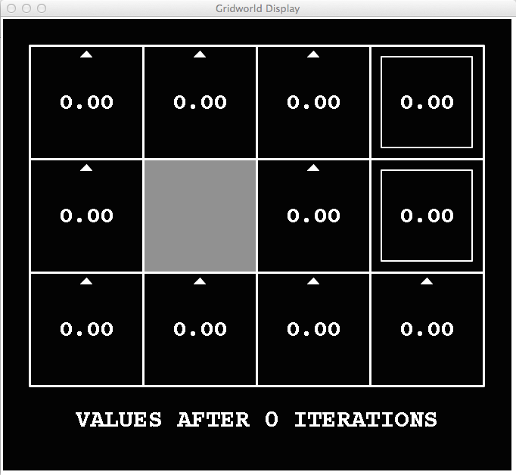
k=0
Noise = 0.2
Discount = 0.9
Living reward = 0
Notes:
At V0 we don’t have any values.
We’re going to walk through this twice. On the first time take a look at the arrows and when they change. At first they change a lot, then they slow down, then most of them don’t change at all after about V7 or V8.
Next look at the values in the bottom left. It takes a long time before the values get high enough to effect the arrows.

Slide 49
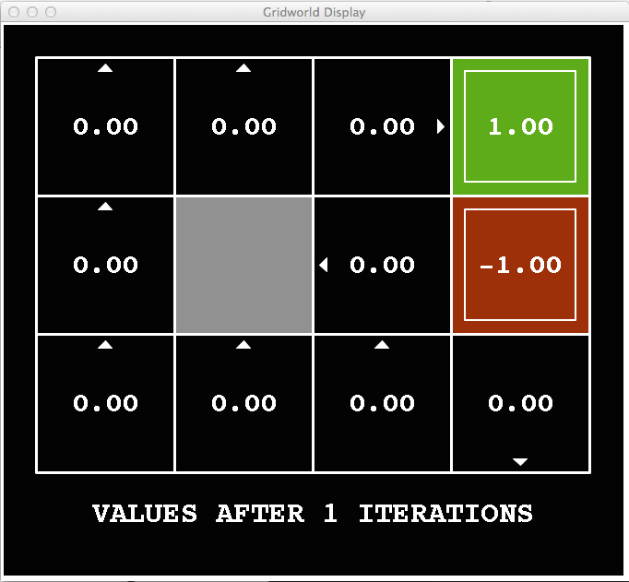
k=1
Noise = 0.2
Discount = 0.9
Living reward = 0
Notes:
We’re going to walk through this twice. On the first time take a look at the arrows and when they change. At first they change a lot, then they slow down, then most of them don’t change at all after about V7 or V8.
Next look at the values in the bottom left. It takes a long time before the values get high enough to effect the arrows.

Slide 50
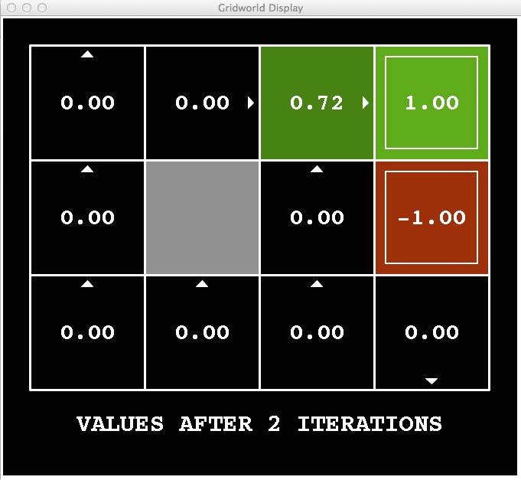
k=2
Noise = 0.2
Discount = 0.9
Living reward = 0
Notes:
We’re going to walk through this twice. On the first time take a look at the arrows and when they change. At first they change a lot, then they slow down, then most of them don’t change at all after about V7 or V8.
Next look at the values in the bottom left. It takes a long time before the values get high enough to effect the arrows.

Slide 51
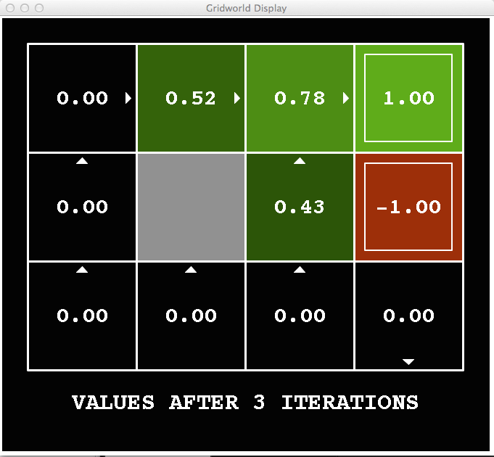
k=3
Noise = 0.2
Discount = 0.9
Living reward = 0
Notes:
We’re going to walk through this twice. On the first time take a look at the arrows and when they change. At first they change a lot, then they slow down, then most of them don’t change at all after about V7 or V8.
Next look at the values in the bottom left. It takes a long time before the values get high enough to effect the arrows.

Slide 52

k=4
Noise = 0.2
Discount = 0.9
Living reward = 0
Notes:
We’re going to walk through this twice. On the first time take a look at the arrows and when they change. At first they change a lot, then they slow down, then most of them don’t change at all after about V7 or V8.
Next look at the values in the bottom left. It takes a long time before the values get high enough to effect the arrows.

Slide 53

k=5
Noise = 0.2
Discount = 0.9
Living reward = 0
Notes:
We’re going to walk through this twice. On the first time take a look at the arrows and when they change. At first they change a lot, then they slow down, then most of them don’t change at all after about V7 or V8.
Next look at the values in the bottom left. It takes a long time before the values get high enough to effect the arrows.

Slide 54

k=6
Noise = 0.2
Discount = 0.9
Living reward = 0
Notes:
We’re going to walk through this twice. On the first time take a look at the arrows and when they change. At first they change a lot, then they slow down, then most of them don’t change at all after about V7 or V8.
Next look at the values in the bottom left. It takes a long time before the values get high enough to effect the arrows.

Slide 55

k=7
Noise = 0.2
Discount = 0.9
Living reward = 0
Notes:
We’re going to walk through this twice. On the first time take a look at the arrows and when they change. At first they change a lot, then they slow down, then most of them don’t change at all after about V7 or V8.
Next look at the values in the bottom left. It takes a long time before the values get high enough to effect the arrows.

Slide 56

k=8
Noise = 0.2
Discount = 0.9
Living reward = 0
Notes:
We’re going to walk through this twice. On the first time take a look at the arrows and when they change. At first they change a lot, then they slow down, then most of them don’t change at all after about V7 or V8.
Next look at the values in the bottom left. It takes a long time before the values get high enough to effect the arrows.

Slide 57

k=9
Noise = 0.2
Discount = 0.9
Living reward = 0
Notes:
We’re going to walk through this twice. On the first time take a look at the arrows and when they change. At first they change a lot, then they slow down, then most of them don’t change at all after about V7 or V8.
Next look at the values in the bottom left. It takes a long time before the values get high enough to effect the arrows.

Slide 58

k=10
Noise = 0.2
Discount = 0.9
Living reward = 0
Notes:
We’re going to walk through this twice. On the first time take a look at the arrows and when they change. At first they change a lot, then they slow down, then most of them don’t change at all after about V7 or V8.
Next look at the values in the bottom left. It takes a long time before the values get high enough to effect the arrows.

Slide 59

k=11
Noise = 0.2
Discount = 0.9
Living reward = 0
Notes:
We’re going to walk through this twice. On the first time take a look at the arrows and when they change. At first they change a lot, then they slow down, then most of them don’t change at all after about V7 or V8.
Next look at the values in the bottom left. It takes a long time before the values get high enough to effect the arrows.

Slide 60

k=12
Noise = 0.2
Discount = 0.9
Living reward = 0
Notes:
We’re going to walk through this twice. On the first time take a look at the arrows and when they change. At first they change a lot, then they slow down, then most of them don’t change at all after about V7 or V8.
Next look at the values in the bottom left. It takes a long time before the values get high enough to effect the arrows.

Slide 61

k=100
Noise = 0.2
Discount = 0.9
Living reward = 0
Notes:
We’re going to walk through this twice. On the first time take a look at the arrows and when they change. At first they change a lot, then they slow down, then most of them don’t change at all after about V7 or V8.
Next look at the values in the bottom left. It takes a long time before the values get high enough to effect the arrows.

Slide 62
Problems with Value Iteration
Value iteration repeats the Bellman updates:
Problem 1: It’s slow – O(S²A) per iteration
Problem 2: The “max” at each state rarely changes
Problem 3: The policy often converges long before the values
s
a
s, a
s,a,s’
s’
Notes:
[Re-iterate the problems.]
So what can we do?

Slide 63
Policy Iteration
Alternative approach for optimal values:
Step 1: Policy evaluation: calculate utilities for some fixed policy (not optimal utilities!) until convergence
Step 2: Policy improvement: update policy using one-step look-ahead with resulting converged (but not optimal!) utilities as future values
Repeat steps until policy converges
This is policy iteration
It’s still optimal!
Can converge (much) faster under some conditions
Notes:
We’re going to look at an alternate called policy evaluation.

Slide 64
Policy Iteration
Evaluation: For fixed current policy π, find values with policy evaluation:
Iterate until values converge:
Improvement: For fixed values, get a better policy using policy extraction
One-step look-ahead:
Notes:
If we wrote this out in equation, it would look like this.
Step 1 is evaluation. I do this simplified update where I don’t max over the actions. I only do the averaging on the chance nodes. It’s fast, since I don’t consider all of the actions. I do this until it convergences.
Step 2 is the improvement. I do one layer of expectimax. Our truncation function is the old policy. That’s a bit weird right? I’m pushing the old stuff one step into the future and thereby make progress.
If you think about this, the improvement step is just like value iteration. So it’s not going to be very fast. All of the speed gains come from the evaluation step. So we run that many times before allowing an improvement step.

Slide 65
Comparison
Both value iteration and policy iteration compute the same thing (all optimal values)
In value iteration:
Every iteration updates both the values and (implicitly) the policy
We don’t track the policy, but taking the max over actions implicitly recomputes it
In policy iteration:
We do several passes that update utilities with fixed policy (each pass is fast because we consider only one action, not all of them)
After the policy is evaluated, a new policy is chosen (slow like a value iteration pass)
The new policy will be better (or we’re done)
Both are dynamic programs for solving MDPs
Notes:
OK, let’s compare them. They do the same thing. Both take in an MDP. They both output an optimal quality. On the surface they both output optimal values. Policy iteration explicitly outputs the optimal policy, value iteration does it implicitly.
Both are the same class of things. They are dynamic programs for solving MDPs.

Slide 66
Summary: MDP Algorithms
So you want to….
Compute optimal values: use value iteration or policy iteration
Compute values for a particular policy: use policy evaluation
Turn your values into a policy: use policy extraction (one-step lookahead)
These all look the same!
They basically are – they are all variations of Bellman updates
They all use one-step lookahead expectimax fragments
They differ only in whether we plug in a fixed policy or max over actions
Notes:
These are all Bellman equations turned into a one step look ahead.

Slide 67
Next Time: Reinforcement Learning!

